Slide 1
Design
Chris, Quynh, Gavin

Slide 2
Note
Properties:
id: String --Note Name
frequency: double
octave - int

Slide 3
Tuner Class
Inherits Instrument and Note class
Properties:
soundSample: List<float>
cents: int -- For use in displaying how many cents sharp the pitch is
pitchCorrectness: float -- For computations. The exact hz difference, not just an integer
pitch_table: List<Note>
instrument_list: List<instrument>
temperament: float
closestNote: Note
dbThreshold: float
Methods
findClosestNote(): Note

Slide 4
Instrument Class
Properties:
name: string
num_strings: int
insturment_strings: List<Note>
presetTunings: List<Note>
Methods:
setInstString(Note): void

Slide 5
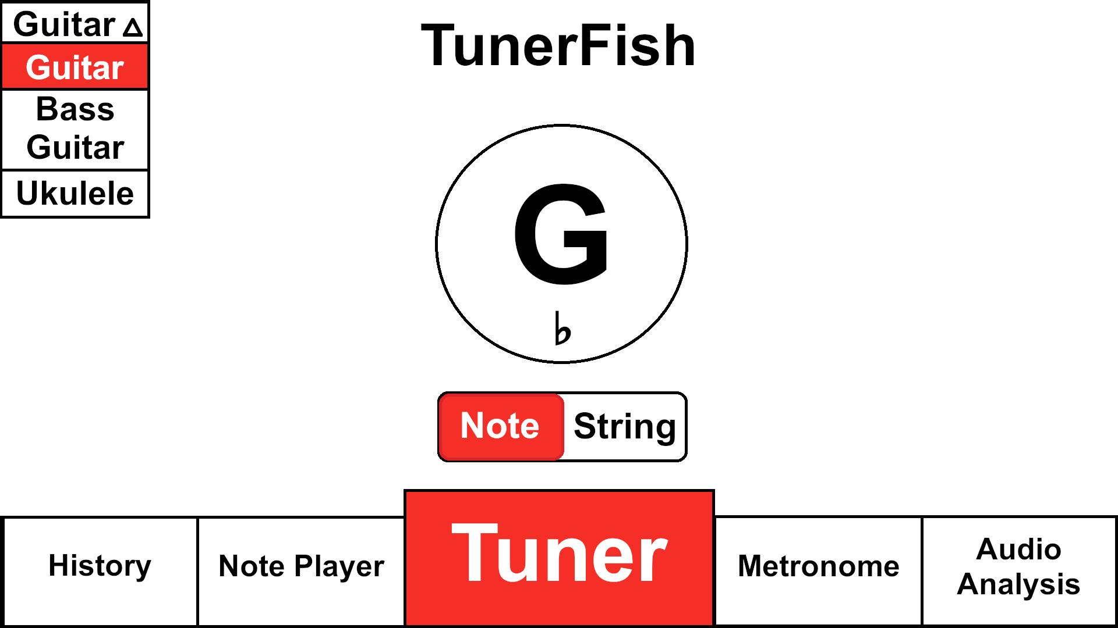
Visual Desing

Slide 6
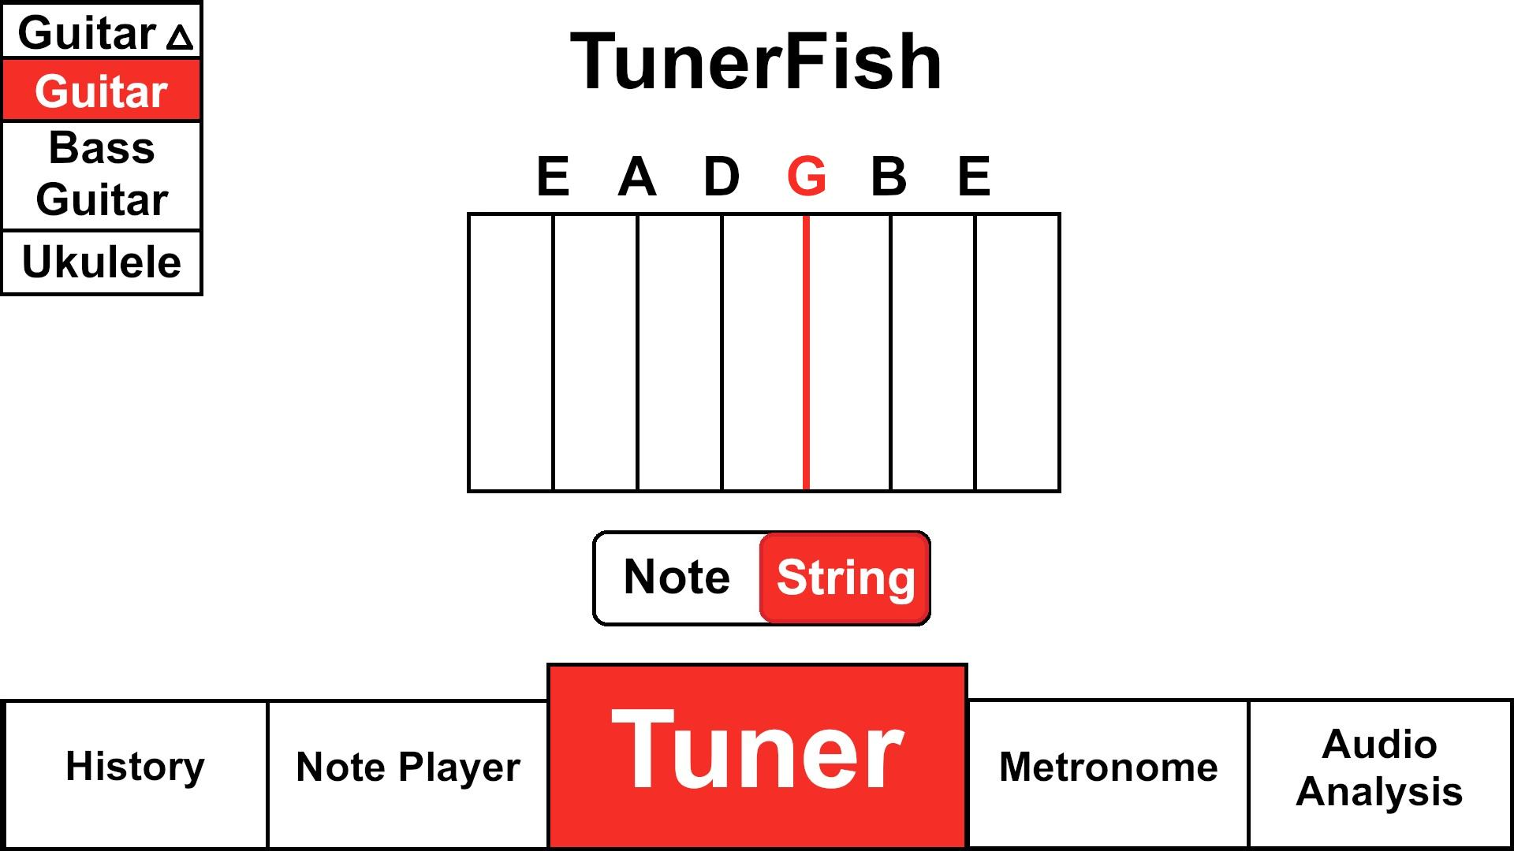

Slide 7
Metronome feature
Metronome class:
properties:
tempo: float
beat: int
isPlaying: bool

Slide 8
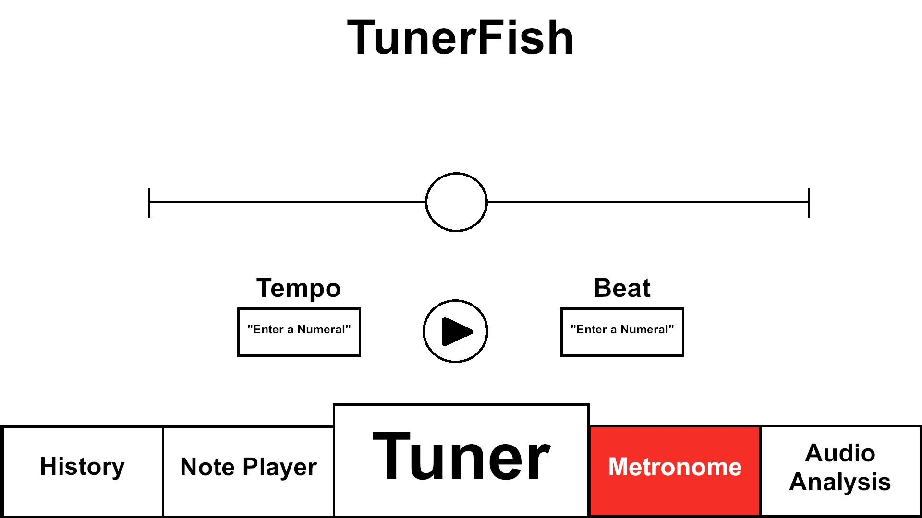

Slide 9
Audio Analysis feature
Inherited from Note class
AudioAnalysis class:
properties:
noteDetected: bool
closestNote: Note
freeze: bool
Methods:
ClearFrozen(): void

Slide 10
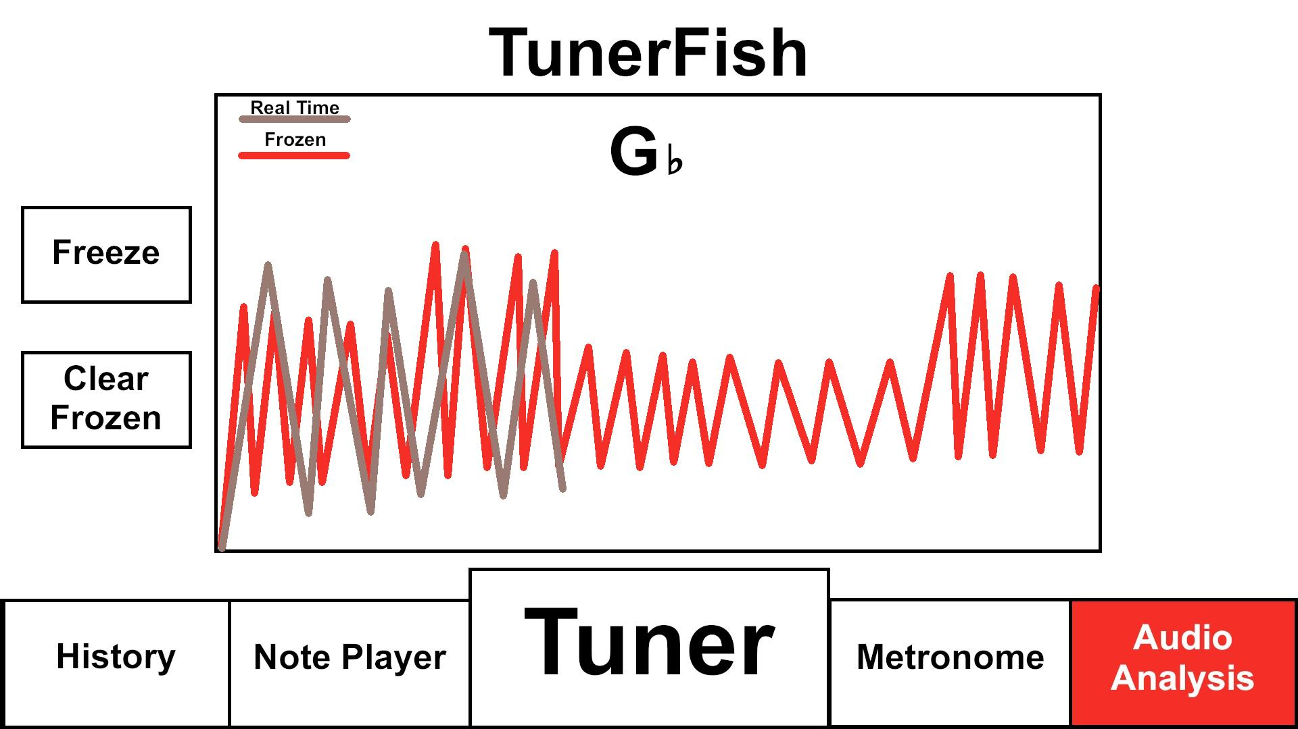

Slide 11
Note Player Feature
Inherited from Note class
NotePlayer class:
Properties:
note: List<Note>
beingSustained: bool
beingPlayed: bool
Methods:
sustained(beingSustained): void
play(beingPlayed): void

Slide 12
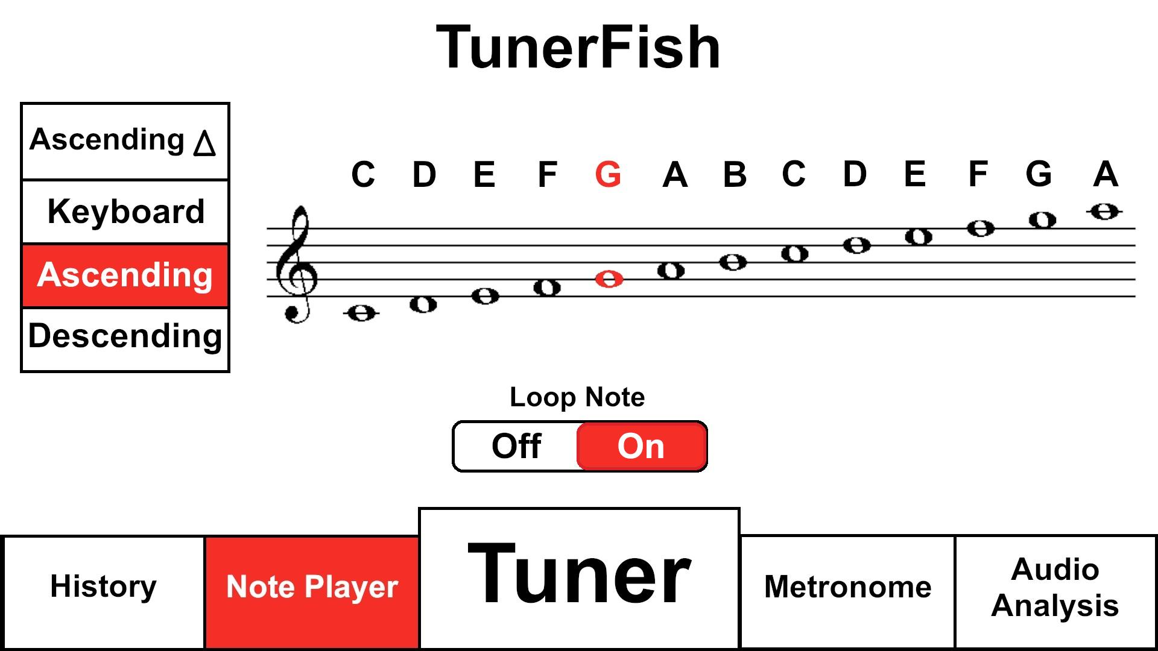

Slide 13
History feature
Have history and Event classes

Slide 14
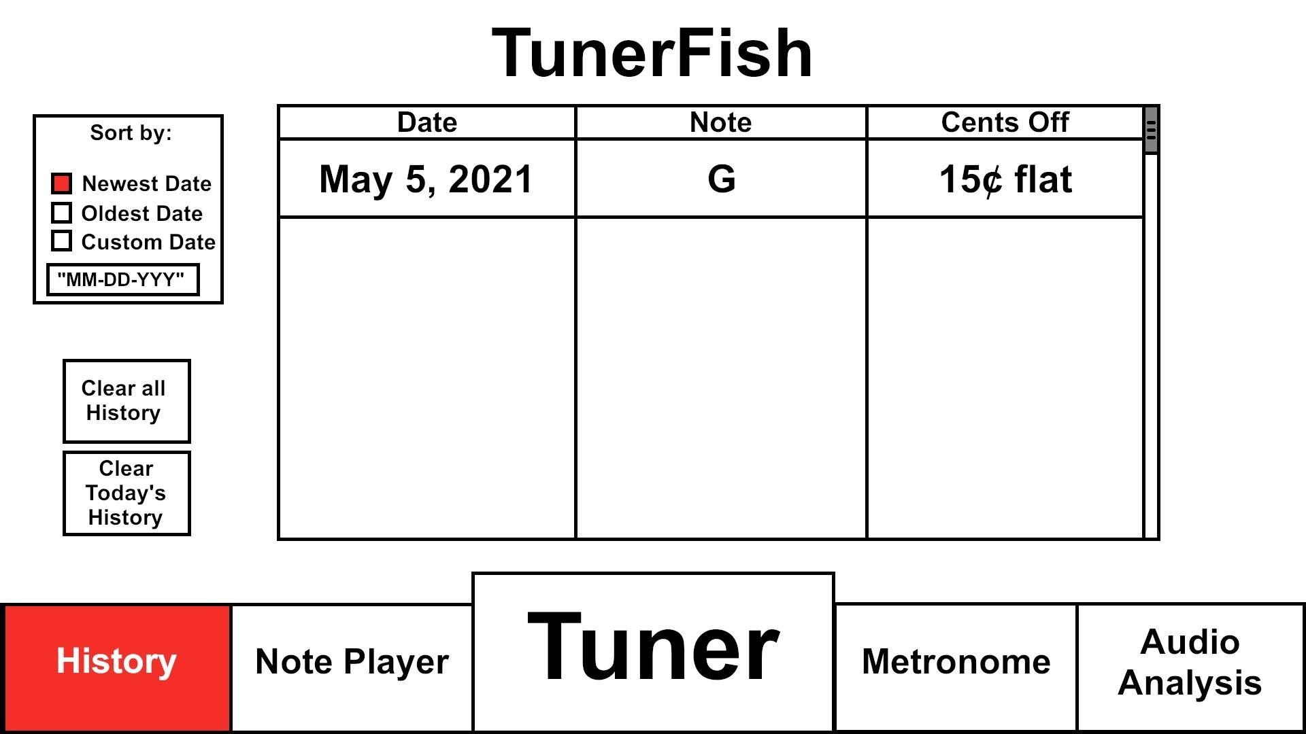

Slide 15
Event Class
Inherited from Note class
properties:
date: DateTime
name: string
note: Note
tuning: int

Slide 16
History class
Properties:
Events: List<Event>
Methods:
DeleteEvent(event; Event): void
AddEvent(event; Event): void
Clear(): void

